Slide 1
Maarit
7 May 2024

Slide 2
Factors: 1. Straw
Straw removal
Straw retained
Tillage (nested within straw)
Intense
Moderate
No-till
Cover crops (nested within straw x tillage)
Ryegrass + red clover, early season package
Ryegrass + red clover, mid-season package
Radish, late-season just after harvest package
Radish, mid-season 14 days before harvest package
No cover
Block
1, 2, 3, 4
Growing season
2018 (wet)
2019 (dry)

Slide 3
Year 1
Straw
No
straw

Slide 4
Year 1
Straw
No
straw
Low
High
Med

Slide 5
Year 1
Straw
No
straw
Low
High
Med

Slide 6
Year 1
Year 2
Same plot placements and treatments from year to year

Slide 7
Precipitation

Slide 8
Responses: 1. Fall vegetation
Percent cover (3 obs / plot)
Catch crop
Soil
Volunteer
Weeds
Biomass (2 obs/plot)
Catch crop
Weeds
Following spring weeds
Numbers of weeds per m2 of four groups
Dicot weeds
Monocot weeds
Thistle
Horsetail
3. Following crop yields

Slide 9
Some questions
Complicated nesting, not sure how to best do it in R
Maybe I should use JMP or have Bo do SAS
Response variables
Percentage cover
If just comparing % cover of one category between treatments, do I need to take into account the values are bounded by 0 and 100?
Multivariate analysis (each category of cover is a response variable?)
Count data…haven’t researched anything on that yet…

Slide 10
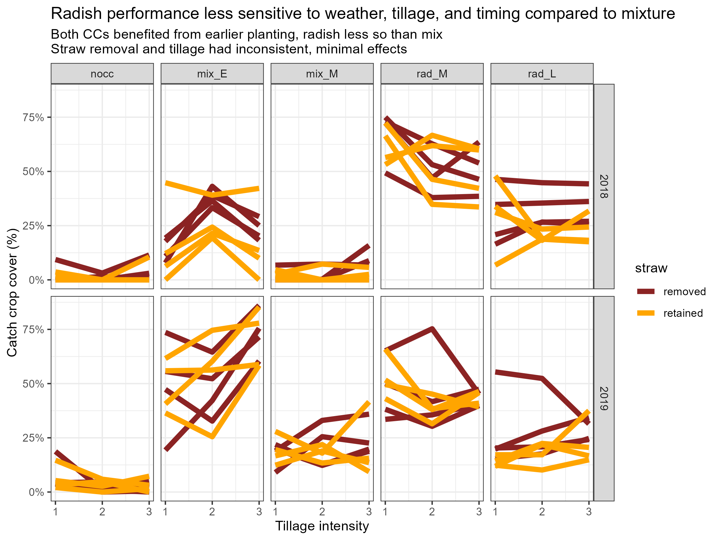

Slide 11
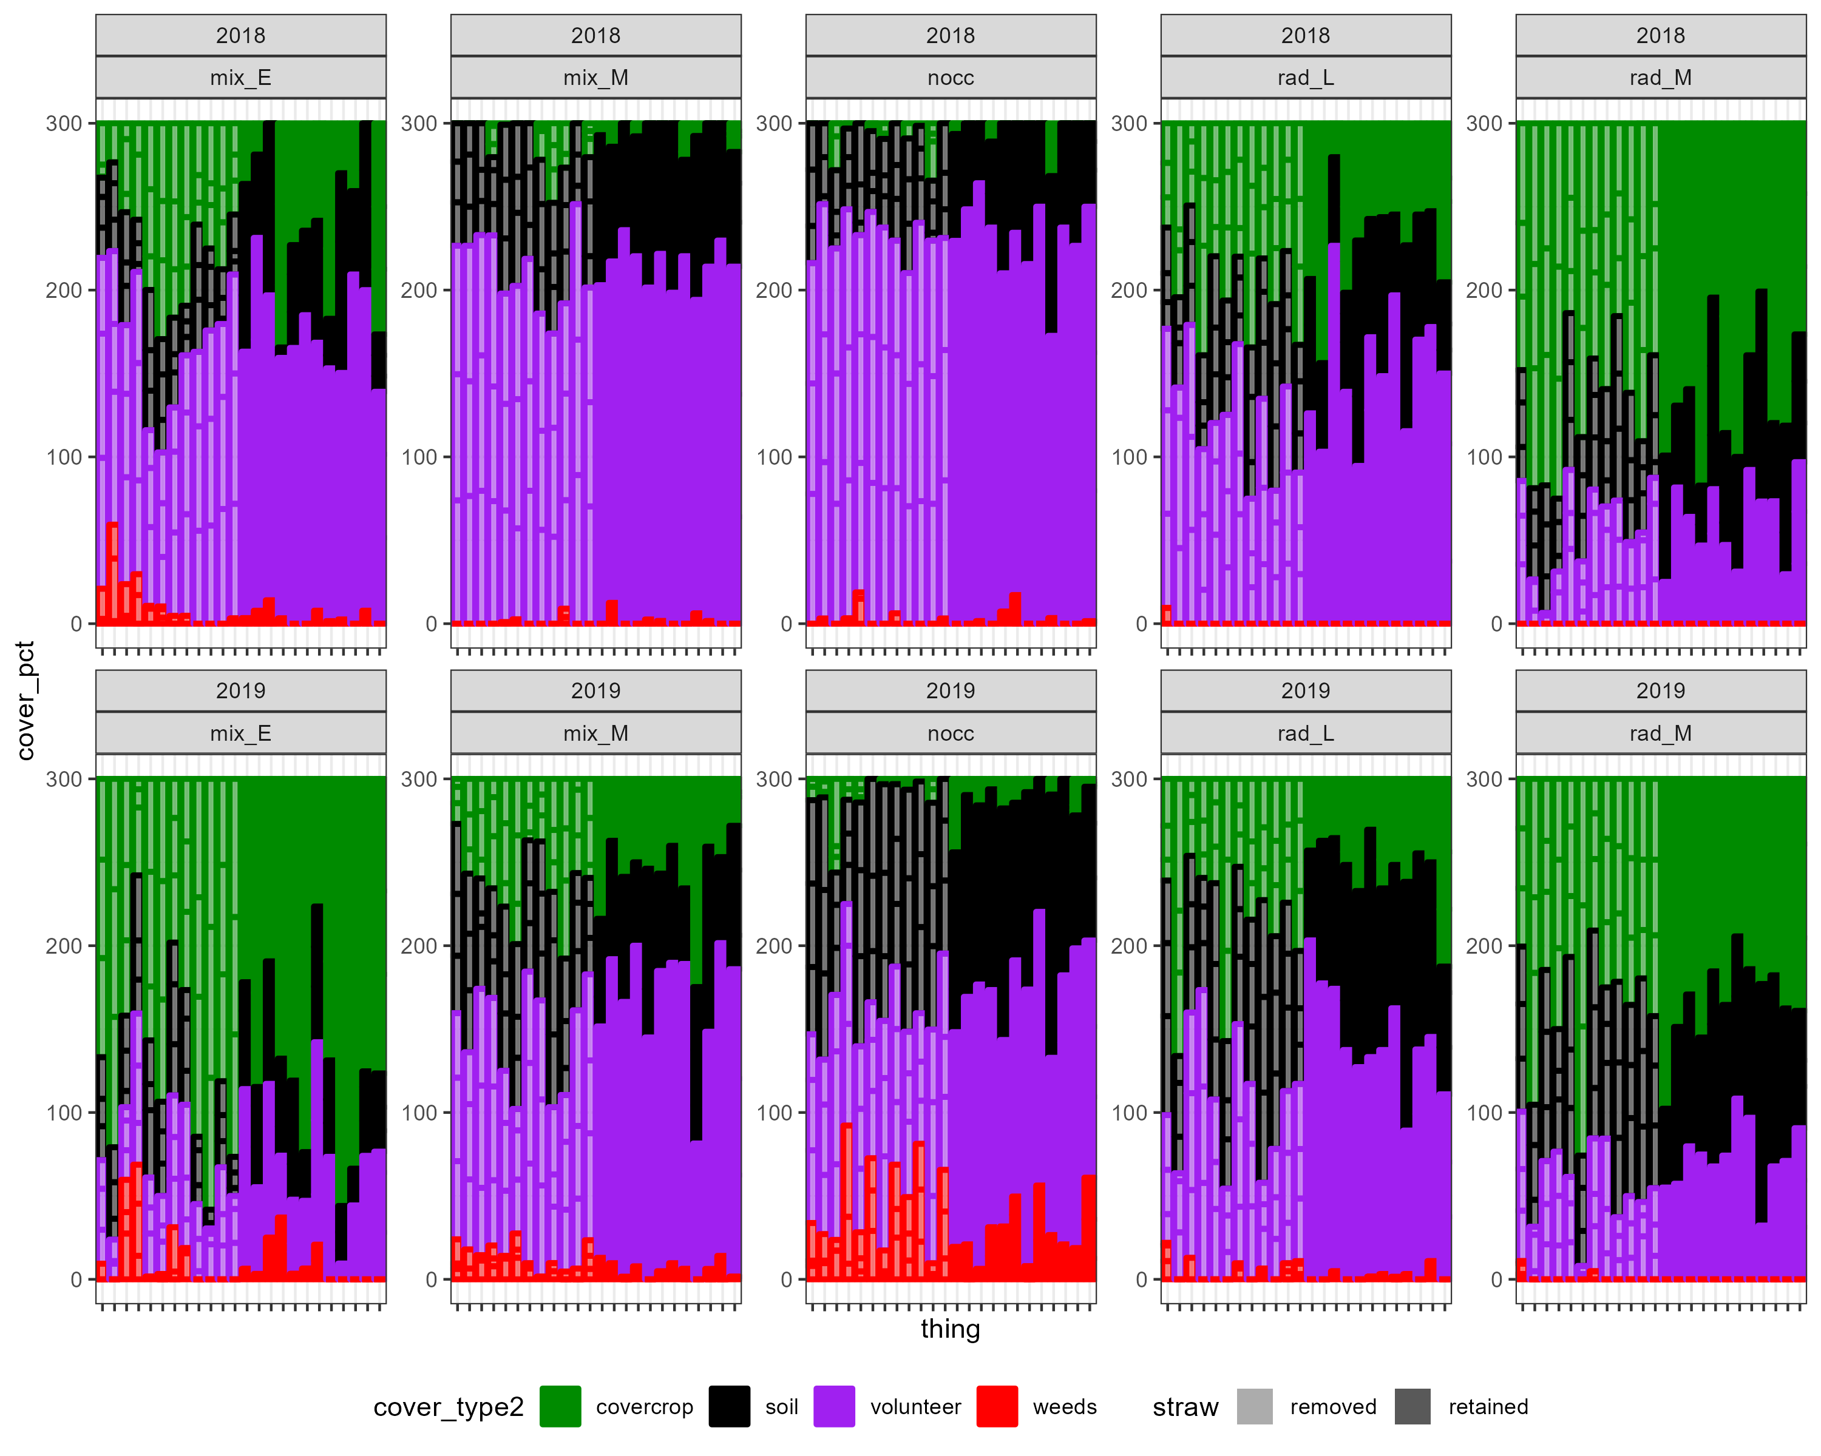
Dry post-harvest
Wet post-harvest

Slide 13
2018

Slide 14
2019

